Slide 1
Medical Open Enrollment 2023 9/18/23-10/13/23
Payroll and Benefits Department
José Chang – Senior Payroll & Benefits Analyst
Lisa D. Martin – Payroll & Benefits Manager

Slide 2
Navigating open enrollment
Reviewing Rates
Reviewing Coverages
Comparing Plans
Making Changes
Waiving Medical

Slide 3
NAVIGATING myCalPERS
The best method of reviewing medical rates, comparing plans, and making changes is to log into your account at my.calpers.ca.gov. Both CalPERS and CalSTRS members can utilize this. If you are a CalSTRS member and do not currently have medical coverage or a myCalPERS account, please contact Payroll.

Slide 4
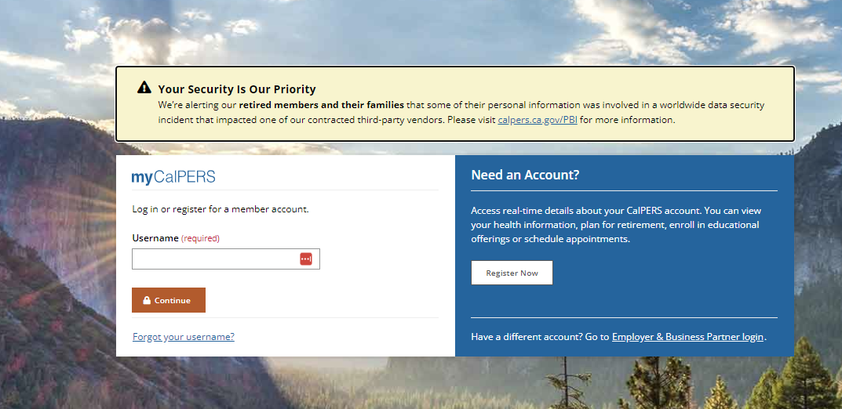

Slide 5
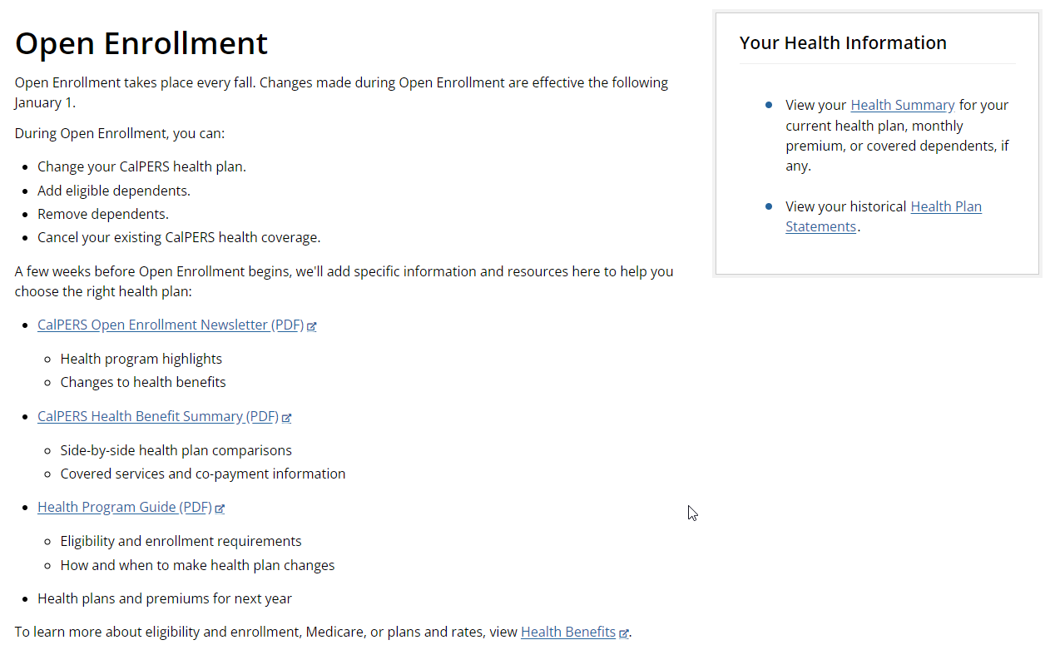

Slide 6
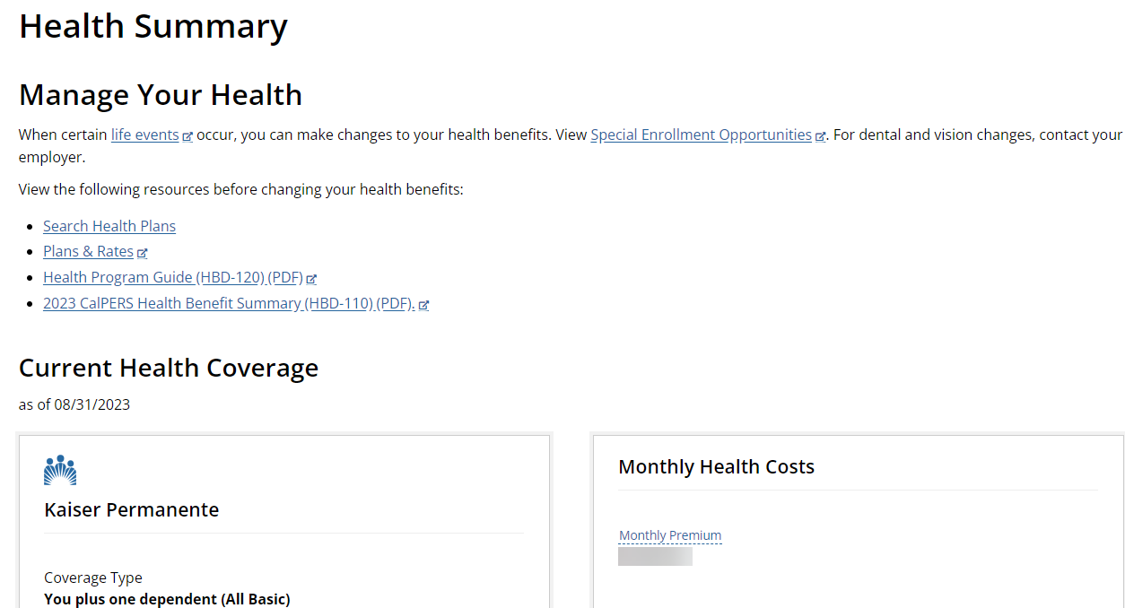
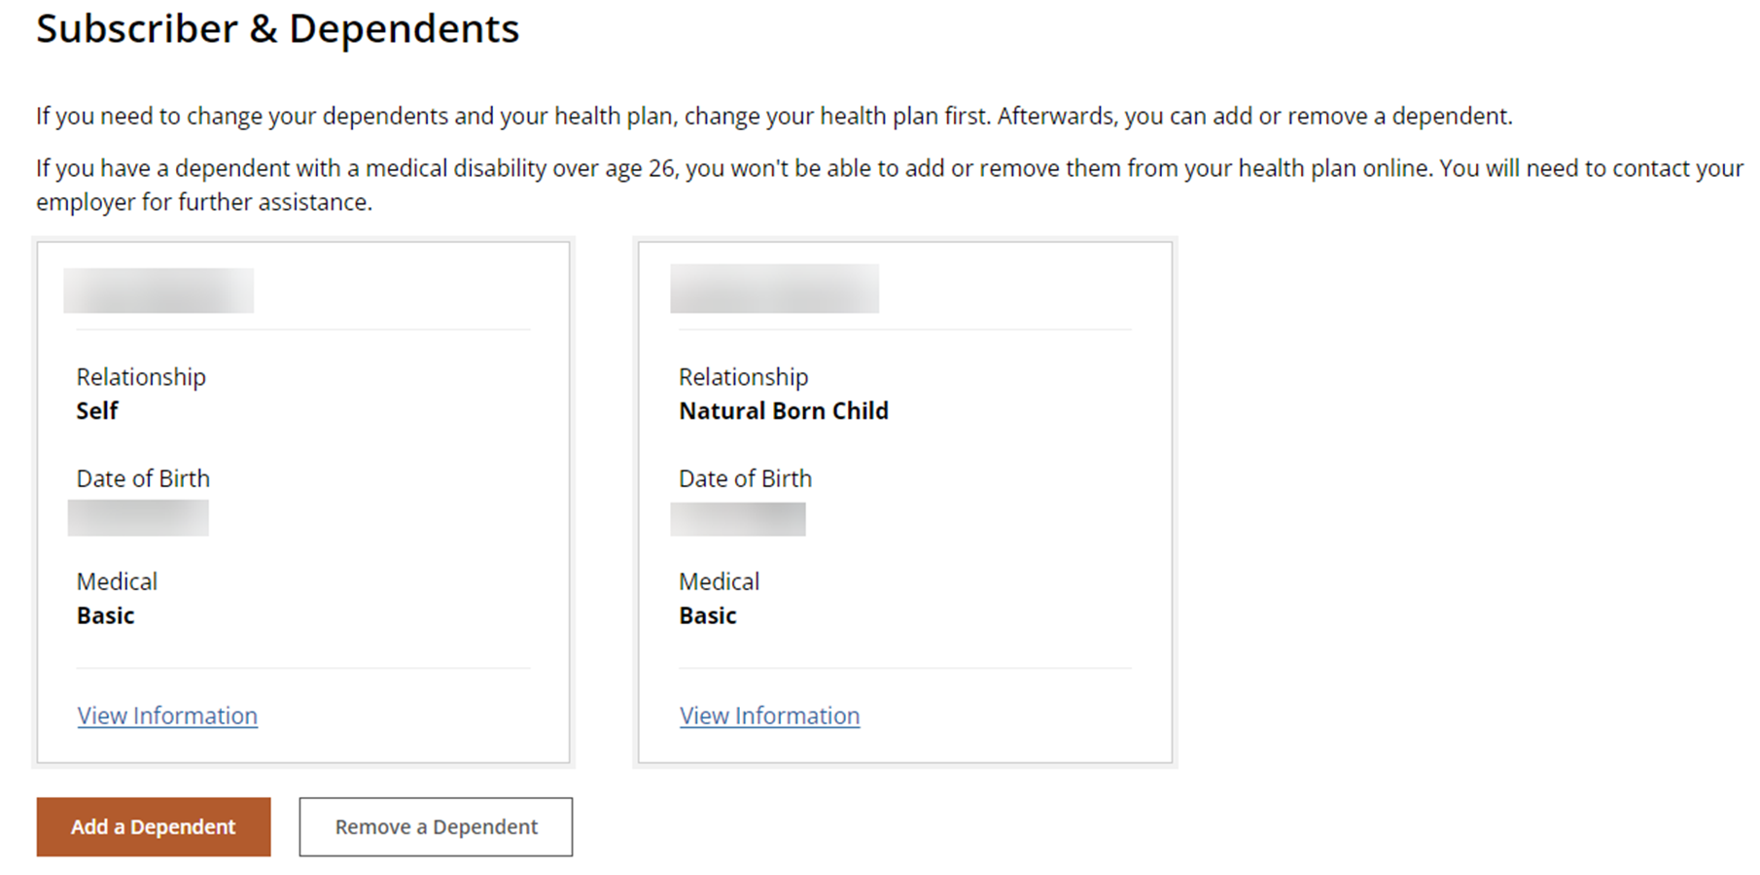

Slide 7
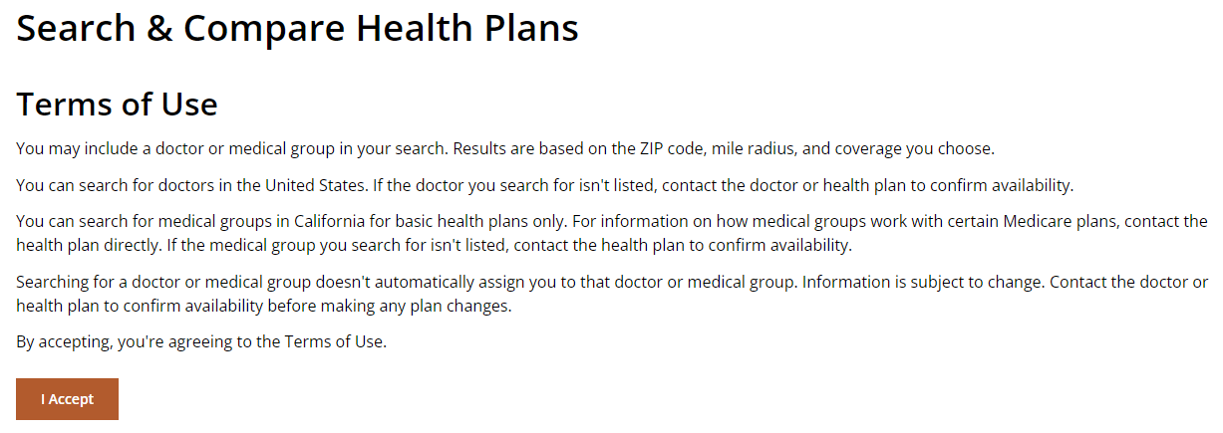
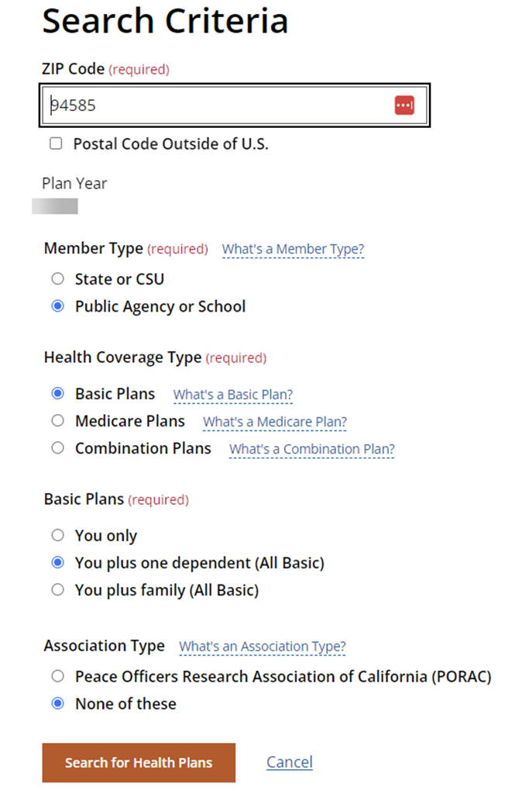
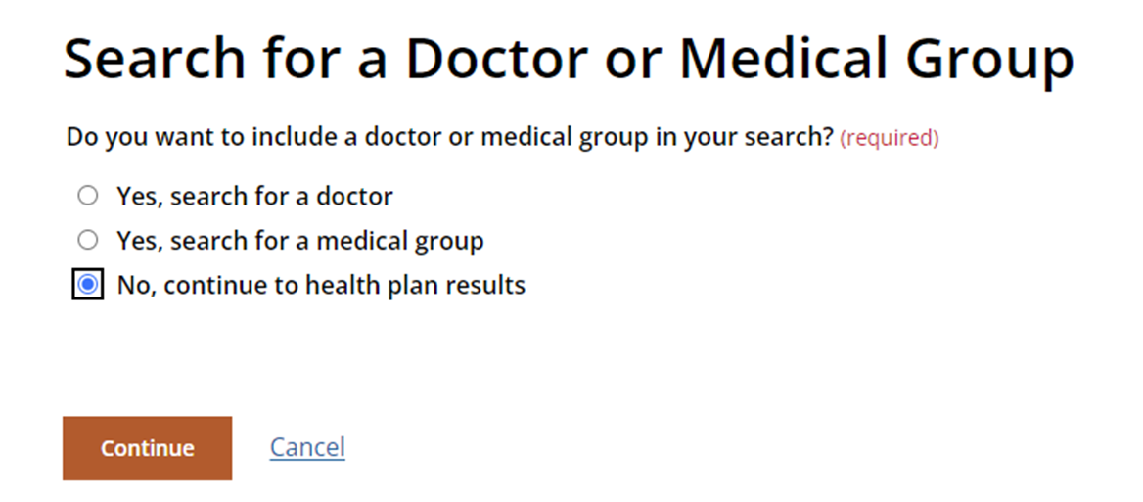

Slide 8
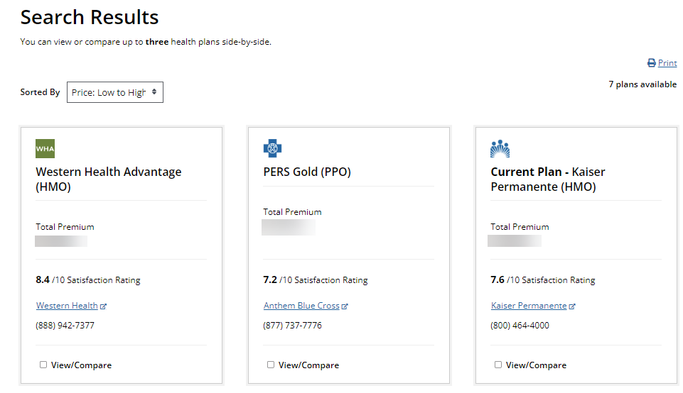

Slide 9
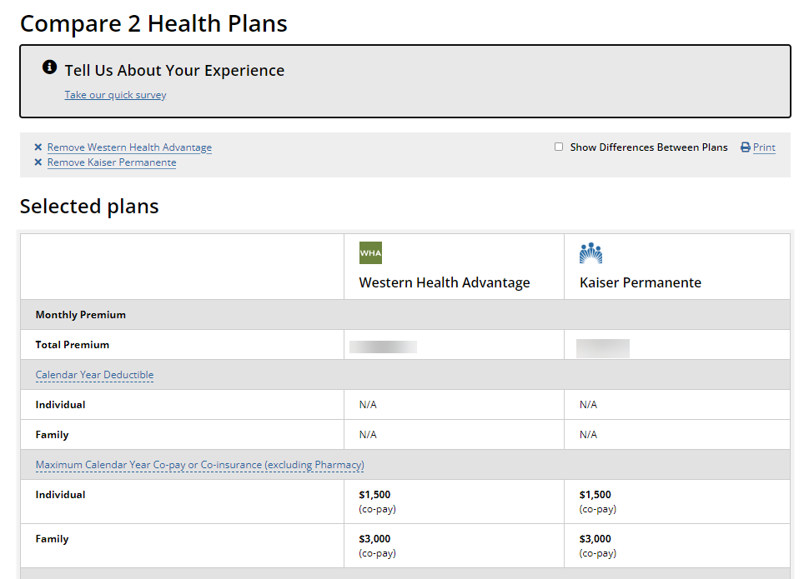

Slide 10
Anthem Blue Cross HMO & EPO (855) 839-4524 www.anthem.com/ca/calpers
Kaiser Permanente (800) 464-4000 www.kp.org/calpers
Blue Shield of California (800) 334-5847 www.blueshieldca.com/calpers
PERS Gold & PERS Platinum (877) 737-7776 www.anthem.com/ca/calpers
UnitedHealthcare (877) 359-3714 www.uhc.com/calpers
Western Health Advantage (888) 942-7377 www.westernhealth.com/calpers

Slide 11
Have more questions about open enrollment? CalPERS answers many of your questions here: https://www.calpers.ca.gov/page/active-members/health-benefits/open-enrollment
You may complete your enrollment, cancellation, or changes online in myCalPERS or by sending a paper form to the Payroll Department prior to the end of open enrollment.
If you are choosing to waive medical coverage, we ask that you complete the medical waiver form for 2024. We request this annually, even if you have recently been hired so that we have documentation that you have been offered medical coverage and that you are aware of your right to enroll.
All changes made during open enrollment are effective January 1, 2024, and payroll deduction changes (if applicable) will begin December 2023.
Please note that Health Net SmartCare will no longer be available in 2024. If you are currently enrolled in a Health Net plan and do not choose a new provider, you will automatically be enrolled in Blue Shield Access+.
Video walkthrough is available here: https://www.youtube.com/watch?v=fIA_bfKfpVI

Slide 12
Summary
If you have reviewed your current medical coverages and the 2024 rates and do not wish to make any changes, no action is required.
If you do not currently have medical coverage through SCOE, and do not wish to enroll, we ask that you sign a 2024 medical waiver form.
If you would like to make changes, you may do so in your myCalPERS account or by completing the HBD-12 Health Enrollment Form and returning it to the Payroll Department prior to October 13, 2023.

Slide 13
Thank you
SCOE Payroll
scoepayroll@solanocoe.net
https://www.solanocoe.net/Administrative-Services--Operations/Payroll--Benefits/index.html

